Slide 1

WHY CLOUD ASSESSMENT ?
Risks
Benefits
Applications sit on cloud with higher cost
Lack of clarity on migration Risks and Mitigations
Application incompatibility / complexity
and failure post migration
Data Security and Compliance risks
Unstructured and ambiguous migration approach
Misinterpret workloads/ resources / dependencies
Optimized infrastructure cost
Complete visibility of underlying Infra and application dependencies and redundancies and associated risks of migration
Improved Scalability / Elasticity / Reliability
Enhanced Security features
Preparedness for the right sequence of migration
Aids in the planning of future expenditure

Slide 2








HCL’s Assessment Approach
INITIATE & PREP
EXPLORE
ANALYZE
CRAFT
Assessment Deliverables
CMDB
Full Asset report
(i.e. how many servers, RN150 can communicate with)
Accessible & not accessible devices
Application/work Details
Versions
Technology
Ports
Services
Interfaces dependencies
Application to machine mapping
Map
HCL ELASTIC ASSESS
Prev. Tools Reports
Process/applications running on each server
IT Landscape Discovery Tools
Standardize
Configuration details & utilization
Application Context
Usage
Business criticality
SLAs
Complexity
Discovery Tool
Communication/protocols shared between servers
Workshops
Infra Analysis
Instances Configurations
Network Interfaces
Security Measures
Consolidated Application Information, Database
Application Owners
Assessment Lead
Technology SME
Project manager
Domain Analyst
Cloud Architect
App Architect
Cleanse
Application Treatment Plan for Cloud Fitment
Questionnaire
Suggestion on treatment plan (further assessment required)

Slide 3

Plan & Explore
Analysis
Assessment Process Workflow
Craft
1
2
3
4
5
Customer
Analysis
Gather the existing documents
Finalized IP Range for discovery
Database credentials
Firewall Dump
Docs
Stakeholders
Application Owner/SME
Vendor (COTS)
Infra Owner
Security & Compliance Owner
Infrastructure Details
Application Components
Application Architecture
Complexity
Business Criticality
Database & Middleware
Output :
Draft Analysis Report for the discussion with Customer
Existing CMDB
Inter-Dependencies
Is Accurate Inventory or discovery tool exists?
Map Application with Server
?
Y
Authentication Details
Access Details
Latency
Integration with AD /LDAP
1
Workshop for Complex & Inaccessible Application
Planning and explore the extract of existing tool
Output: Signed Off Data
Owners & Vendor Details
Business Criticality & Defined SLAs
Application Technology/Frameworks
Finalized Server Inter dependencies
Application to Application Integrations and their parameters Application Architecture (Physical & Logical Architecture), Deployment Details
Shared Services/Storages
Firewall & Load balancers
Database their tenancy details and future roadmap
Latency Details (App/Services/DB)
DR Details & future requirement (RTO & RPO)
Current data Compliance details
Backup & Retention Polices
Application Details
Performance Data
N
Business Drivers
Shared Services
Backup & Storage
Application Dependencies (Internal & External)
4
CMDB
Application-Server Mapping
Tool Installation Pre-requisite
App Owner Details
Output
Finalized Project Plan
Finalized Application Name
Application Interdependencies
Server - Server Mapping
Full Asset Details
Database connection
& Instance details
Firewall Dump
Workshop Schedule
Finalized Questionnaire
Pre-Filled Questionnaire
Craft
Application Architecture
Asset Summary
Application Complexity
Dependency Report
Planning & Tool Based Discovery
Database & Middleware
Key stakeholders Details
Supportability
Tool Procurement
DR Requirements
Customer Stakeholders
Sign-Off on Report
Operating System, Databases, Middleware Spread
Baselining the Inventory
Security & Compliance Requirements
Tool Installation
3
Workload/Technology Specific recommendations
Customer
Tool Discovery
Recommended Move Groups
Docs
Workshop Planning
2
Target Recommended Compute Sizing
5

Slide 4


WE USE ROBUST TOOLS TO DERIVE GREATER INSIGHT
Right set of tools based on scenario and ground conditions (One size does not fit all)
Scenario
1
Scenario
2
Scenario
3
Scenario
4
Discovery
Assessment Validation
Discovery + Assessment Validation
Discovery + Full Assessment
Identification of workloads, server specifications and traffic with the help of known discovery tools like Cloudscape, Cloudamize etc.
Validation of any existing cloud readiness or discovery validation made by Customer or a vendor.
Identification of workloads, server specifications and traffic with the help of known discovery tools like Cloudscape etc. Validation of any existing cloud readiness or discovery validation made by Customer or a vendor.
Identification of workloads, server specifications and traffic with the help of known discovery tools like Cloudscape etc. Full fledge workshop to conclude best cloud strategy for business as well as Infra application.
****
We also leverage other sources of information such as CMDB, Wiki Portal, Application Technical Artefacts, Arch docs etc.
Discovery strategy
Discovery strategy
Discovery strategy
Discovery strategy
Cloud discovery tool
Discovery not needed but DPRIZM tool used for Analysis
Cloud discovery tool + DPRIZM
Cloud discovery tool
+ DPRIZM + Questionnaire
Workshops
Cloudamize
Cloudamize
Cloudamize
Cloud Accelerate Toolkit

Slide 5
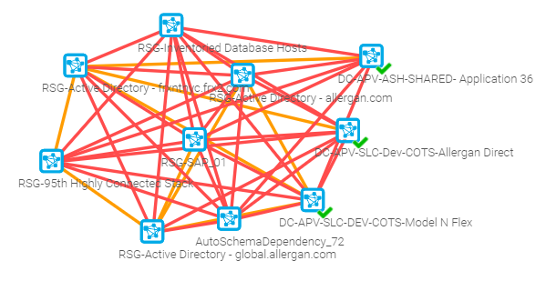
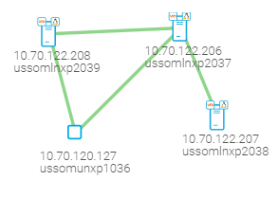
Cloudscape Output (SAMPLE)
Application Stack
Dependent Stack
Application list | Cloudscape Application Name | Hostname | Cloudscape Hostname | Cloudscape IP Address | Environment | Operating System | Cloudscape OS | Middleware | Cloudscape Middleware | Database | Cloudscape Database
Revitas |  | USSLCLNXD2025 | RISCdecom - usslclnxd2025 | RISCdecom-10.15.163.173 | Dev | Linux | Red Hat Enterprise Linux 6 (64-bit) | JBoss
Revitas |  | USSLCLNXD2026 | RISCdecom - usslclnxd2026 | RISCdecom-10.15.163.174 | Dev | Linux | Red Hat Enterprise Linux 6 (64-bit) | JBoss
Revitas | DREVITAS ORA | USSLCUNXD1024 | usslcunxd1024 | 10.15.120.114 | Dev | AIX | AIX 7.2 |  |  | Oracle 11.2 | oracle-11.2.0.4.0
Revitas |  | USSLCLNXD2027 | RISCdecom - usslclnxd2027 | RISCdecom-10.15.163.175 | Dev | Linux | Red Hat Enterprise Linux 6 (64-bit) | Cognos

Slide 6
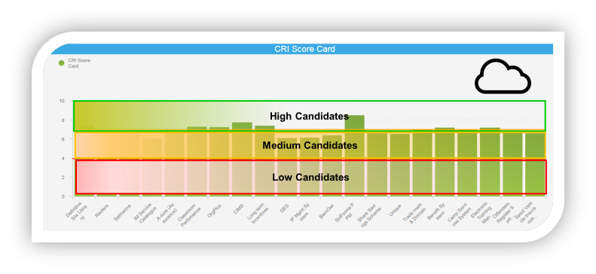
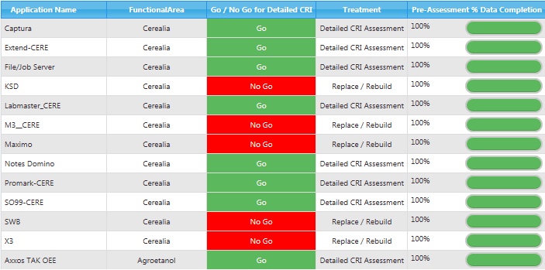
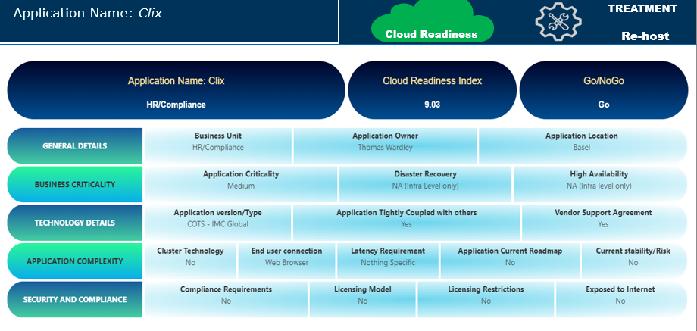
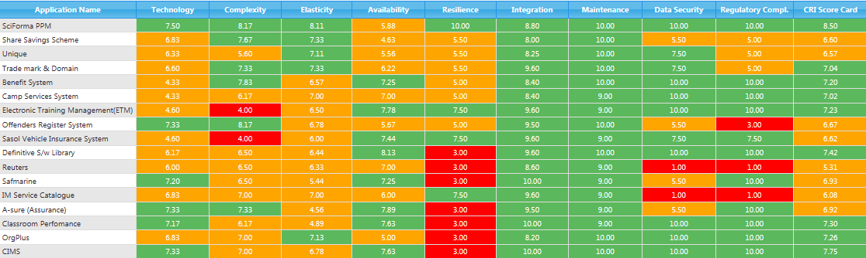
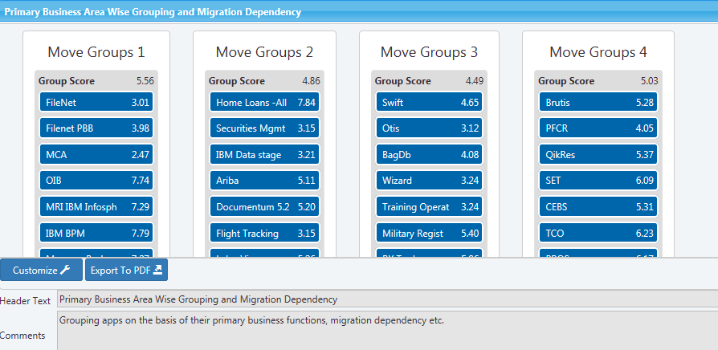
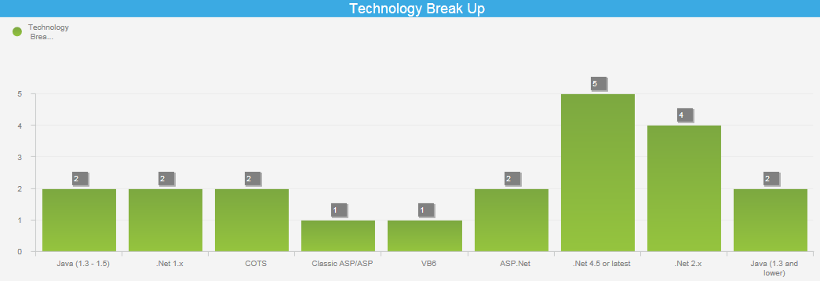
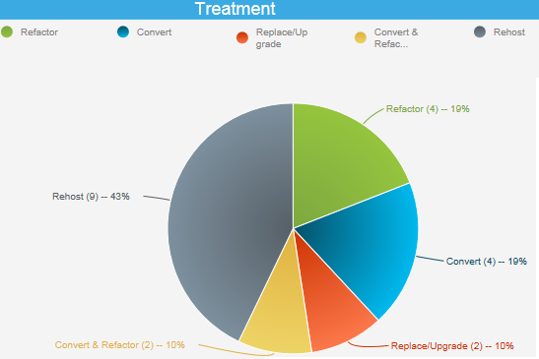
DPrizm – Sample Outputs
Pre-Assessment –
Go / No Go Analysis
CRI Score Card
This report shows the application-wise ‘Go-No Go’ analysis for each application for a particular end state
This is a high-level assessment which filters out the Cloud Go and Cloud No Go candidates from the portfolio. Go candidates will be shortlisted for detailed level assessment.
This report shows Cloud Readiness index for each application for migration to cloud or to a new infrastructure.
This report will help to categorize applications into High (High Affinity for Cloud), Medium (Moderate Affinity for cloud) and Low zones (Low Affinity for cloud).
AS-IS Application
Overview
CRI Heatmap
This report shows the overall summary of the ‘AS-IS’ for each application. i.e. Provides visibility on technical platform, business functions, application criticality, app stability etc.
This report shows the individual score for each parameter for each application for Cloud Readiness index
Wave group Planning
AS-IS Portfolio
and Treatment
This report presents wave group planning for workloads migration in right sequence.
.
This shows some of the AS-IS views of the current customer’s portfolio
and treatment recommendations .

Slide 7
Sample Recommendation Template – Tool + Workshops
Application Name: Receivables Management |  |  | Description: Receivables Management (RM) is a global web solution to support Customer business in proactively managing customer receivables. It is built on Java and Oracle technology. Collectors, account project managers, project controllers, account logistics managers, logistics coordinators, CT controllers, credit controllers, logistics key users, F&C key users and SSO Key Users are the group of persons who use this tool. |  |  | Interface 0-4
ASSESSMENT & RECOMMENDATION |  |  |  |  |  | Treatment
 | Application & Database Operating System Version |  |  |  | Application & Database Technology | GO Containerize / Re-Platform / AKS or Azure App Services
AS IS | Application OS- RHEL 5.11, SOLARIS 10, SOLARIS 11 Database OS- SOLARIS 10, SOLARIS 11 |  |  |  | Oracle 11gR2, Java 1.7, Tomcat 7.0.53
Treatment | Containerize / Re-Platform / Azure PaaS |  |  |  | Re-Platform / Azure PaaS
Target Recommendation | Re-Host Application on -RHEL 7+ / SUSE Linux 11 SP4, 12 SP1+ Re-host Database on - Oracle Linux Or AKS / Azure App Service on Linux |  |  |  | Oracle DB 11.2.0.4 upwards ( suggested 12.2.0.2). Java 1.7 or java 1.8, Tomcat 8.5 or Tomcat 9
Other ASSESSMENT parameters | SCOPE | Priority category |  | Business criticality | APPLICATION TYPE
PARAMETER VALUES | Beyond 2020 | 2-Target - Tactical |  | L2 | SELF-DEVELOPED / CUSTOM
Recommended Approach | Recommended Migration Approach – Application Re-Platforming and re-hosting on IaaS or on PaaS – (AKS / Azure App service). Depending on Architecture complexity. Database version upgrade and rehosting on Azure IaaS. The Oracle version can be 11.2.0.4 on cloud but support is due to end in 2021. Hence should be upgraded to 18c. Java 1.7 is supported on Azure. However, recommendation is moving to java 1.8 if minimal code changes are required. Tomcat needs to be upgraded to Tomcat 8.5 and above. For Application instances Operating System to be upgraded to RHEL 7+ and Solaris to be replaced by either RHEL 7+ or Oracle Linux. For Database Operating System will be Oracle Linux as it is certified only on Oracle Linux in Azure. If Customer wants to do OS consolidation, then we can assess feasibility of running both application and database on Oracle Linux on Azure. Assumptions: We have provided the above high-level recommendation based on the above parameters. However, we will need to do a deep dive study of the application’s architecture complexity, dependency with other apps and data flow etc to finalize the recommendation and provide a detailed migration plan.

Slide 8
Appendix

Slide 9
Commercials
Phase |  | Planning |  | Explore |  |  |  |  | Analysis |  |  | Craft
Weeks/Rates |  | Wk1 | Wk2 | Wk3 | Wk4 | Wk5 | Wk6 | Wk7 | Wk8 | Wk9 | Wk10 | Wk11 | Wk12 | Total Week | Rate Per Hour | Total Hours | Total Rate
Assessment Lead(L3) | Onsite | 1 | 1 | 1 | 1 | 1 | 1 | 1 | 1 | 1 | 1 | 1 | 1 | 12 | 141 | 480 | 67680
 | Offshore |  |  |  |  |  |  |  |  |  |  |  |  | 0 |  |  | 0
Application Architect(L3) | Onsite |  |  |  |  |  |  |  |  |  |  |  |  | 0 |  |  | 0
 | Offshore |  | 1 | 1 | 1 | 1 | 1 | 1 | 1 | 1 | 1 | 1 | 1 | 11 | 75 | 495 | 37125
Tool Consultant(L2) | Onsite |  |  |  |  |  |  |  |  |  |  |  |  | 0 |  | 0 | 0
 | Offshore | 1 | 1 | 1 | 1 | 1 | 1 | 1 | 1 | 1 | 1 | 1 | 1 | 12 | 19 | 540 | 10260
Data Analyst(L2) | Onsite |  |  |  |  |  |  |  |  |  |  |  |  | 0 |  | 0 | 0
 | Offshore |  | 1 | 1 | 1 | 1 | 1 | 1 | 1 | 1 | 1 | 1 | 1 | 11 | 19 | 495 | 9405
Project Manager(L3) | Onsite |  |  |  |  |  |  |  |  |  |  |  |  | 0 |  | 0 | 0
 | Offshore | 1 | 1 | 1 | 1 | 1 | 1 | 1 | 1 | 1 | 1 | 1 | 1 | 12 | 41 | 540 | 22140
DB Architect(L3) | Onsite |  |  |  |  |  |  |  |  |  |  |  |  | 0 |  | 0 | 0
 | Offshore |  |  |  |  | 0.5 | 0.5 | 0.5 | 0.5 | 0.5 | 0.5 |  |  | 3 | 29 | 135 | 3915
SAP Consultant(L3) | Onsite |  |  |  |  |  |  |  |  |  |  |  |  | 0 |  | 0 | 0
 | Offshore |  |  |  |  | 1 | 1 | 1 | 1 | 1 | 1 |  |  | 6 | 29 | 270 | 7830
Specialised SME(L3) | Onsite |  |  |  |  |  |  |  |  |  |  |  |  | 0 |  | 0 | 0
 | Offshore |  |  |  |  | 1 | 1 | 1 | 1 | 1 | 1 |  |  | 6 | 36 | 270 | 9720
Cloud Architect(L3) | Onsite |  |  |  |  |  |  |  |  |  |  |  |  | 0 |  | 0 | 0
 | Offshore |  |  |  |  |  | 0.5 | 0.5 | 0.5 | 0.5 | 0.5 | 0.5 |  | 3 | 35 | 135 | 4725
Dprizm(L2) | Onsite |  |  |  |  |  |  |  |  |  |  |  |  | 0 |  | 0 | 0
 | Offshore |  | 0.25 | 0.25 | 0.25 | 0.25 | 0.25 | 0.25 | 0.25 | 0.25 | 0.25 | 0.25 | 0.25 | 2.75 | 19 | 123.75 | 2351.25
Total |  |  |  |  |  |  |  |  |  |  |  |  |  |  |  | 0 | 175151.3

Slide 10
Why Cloudscape is better than Azure Migrate
Platforms | Parameters | CloudScape | Azure Migrate
Agent/Agentless | Agentless | Yes
 | Collect VM and physical server ( windows and Linux) | Yes | Only Vcenter data
Windows Server |  |  | Cannot do
 | Hardware Information |  | Cannot do
 | Serial Number (Dell Service Tag, etc) | Yes | Cannot do
 | Physical Memory | Yes | Cannot do
 | Physical CPU | Yes | Cannot do
 | Physical Hard Drive | Yes | Cannot do
 | HBA Information | Yes | Cannot do
 | Network Card information | Yes | Cannot do
 | Software Information | Yes | Cannot do
 | OS Version | Yes | Cannot do
 | Installed Applications and versions with process ID information | Yes | Cannot do
 | Windows Services and status | Yes | Cannot do
 | Logical Disks | Yes | Cannot do
 | Windows Shares | Yes | Cannot do
 | HTTP get on port 80 | Yes | Cannot do
 | Operational Information | Yes | Cannot do
 | Windows Event Log information (3 days of Errors and Warnings) | Yes | Cannot do
 | Citrix Metaframe Server Inventory | Yes | Cannot do
 | Performance | Yes | Cannot do
 | CPU Performance | Yes | Cannot do
 | Process specific Performance metrics (CPU, Swap, etc) | Yes | Cannot do
 | Memory Performance (bytes used / % used ) | Yes | Cannot do
 | Disk (Logical and Physical) performance (I/O per sec, I/O bytes, latency, etc) | Yes | Cannot do
 | Windows Network Interface Utilization (I/O bytes, etc) | Yes | Cannot do
 | Windows Process Information | Yes | Cannot do
 | Windows Netstat Connectivity Information (opt-in only) | Yes | Cannot do
 | DNS A records and C names where applicable | Yes | Cannot do

Slide 11
Why Cloudscape is better than Azure Migrate
Linux/Unix Server | Parameters | Cloudscape | Azure Migrate
 | Physical Memory | Yes | Cannot do
 | Physical CPU | Yes | Cannot do
 | Physical Hard Drive | Yes | Cannot do
 | Network Interfaces | Yes | Cannot do
 | Software Information | Yes | Cannot do
 | OS Description | Yes | Cannot do
 | Installed Applications and versions with process ID information | Yes | Cannot do
 | Logical Disks | Yes | Cannot do
 | Filesystems | Yes | Cannot do
 | HTTP get on port 80 | Yes | Cannot do
 | Inventory via SSH | Yes | Cannot do
 | Operating System | Yes | Cannot do
 | OS Version | Yes | Cannot do
 | OS Distribution | Yes | Cannot do
 | OS Distribution Version | Yes | Cannot do
 | CPU Architecture | Yes | Cannot do
 | Performance | Yes | Cannot do
 | CPU Performance | Yes | Cannot do
 | Memory Performance (bytes used / % used ) | Yes | Cannot do
 | Physical Disk I/O | Yes | Cannot do
 | Running Processes | Yes | Cannot do
 | Socket Connectivity Information (uses TCP-MIB via SNMP / prefers RFC 4022 version) | Yes | Cannot do
 | Network Interface Utilization | Yes | Cannot do

Slide 12
Why Cloudscape is better than Azure Migrate
 | Parameters | Cloudscape | Azure Migrate
VMWARE | Hardware Information | Yes | Through Vcenter configuration
 | Server Model | Yes
 | Network Connectivity | Yes | Yes . Network performance data if available in Vcenter
 | Physical Memory | Yes | Yes
 | CPU | Yes | Yes
 | Disk Information (size and configuration) | Yes | Yes
 | Software Information | Yes
 | Guest Inventory | Yes
 | OS Version | Yes | YES
 | ESX Location | Yes | No
 | Host Inventory | Yes | No
 | OS Version | Yes | No
 | DataStore mapping to hosts and guests | Yes | No
 | Operational Information | Yes
 | Virtual Switch configuration | Yes
 | Performance | Yes
 | CPU Utilization (wait time, ready time, etc) | Yes
 | Memory Utilization (usage MB, etc) | Yes | Yes
 | Disk Utilization (I/O / sec, bytes/sec, etc) | Yes | Yes
 | Network Utilization (bytes in/out) | Yes | No
DATABASE | MS-SQL,MYSQL and Oracle | Yes | No Separate Agent
 | Hostname | Yes
 | Version | Yes
 | Schemas Names (sometimes referred to as database names) | Yes
 | Connectivity | Yes
 | Table Metadata | Yes
 | Table Names | Yes
 | Performance | Yes
 | Connectivity | Yes
 | Table Names | Yes

Slide 13
Why Cloudscape is better than Azure Migrate
 | Parameters | Cloudscape | Azure Migrate
Discovery Stage | 1. ICMP SWEEP (Only in Opt-in SUBNETS) | 1-7 Days as per Risc Networks Claim | Collects the data using the Vcenter credentials from Vcenter itself
 | 2. Selected Port Scan
 | 3. Match Credentials with Devices
Inventory Stage | 1. revisit Interesting Devices |  | revisit for configuration changes is manual. One has to stop and start discovery again. Deletion of VMS are also not reflected as newer data gets appended and not overwritten
 | 2. Gather Workload Specific Data |  | for historical data depends on the Vcenter metadata
 | 3. Interface with Vcenter ( Credentials required )
Performance Stage | 1. Collect ongoing Dependency and Performance Data | Ongoing performance is captured by appliance for atleast 2-4 weeks | Ongoing performance is done by appliance. For historical information depends on Vcenter history to collect the data
 | 2. Continue till Assessment |  | only performance data , configuration changes are not collected
Deployment |  | RN-150 is centos appliance - Deployed on ESXi / Vcenter/vmware workstation | download .ovf file and create a VM appliance in one of the on-prem vcenter
Data Storage |  | All data is uploaded from the virtual appliance to the RISC Networks SCE using 256-bit TLSv1.2 encryption (AES-256). Before being uploaded, the raw data is encrypted at rest using AES-256 with a 2048-bit asymmetric public key (RSA-2048). Data uploads will occur on regular intervals in order to limit the upload size and are encrypted at rest in a secure repository that is not directly accessible from the internet. | Data storage is in cloud . Collector collects the data and send it to cloud for further analysis
OS Discovery Supported | Unix/Linux/windows | Yes | windows and linux vms

